Slide 1
ADOPTION TRENDS FOR ROOFTOP SOLAR IN NEW YORK STATE 2000 - 2018
Team GreenTech
Vish
Dipesh
Aubrey
Josh B.
UCB EXTENSION DATA ANALYTICS BOOTCAMP – PROJECT #1
Notes:
INTRO - Aubrey – (lumped in w/ next slide)
We elected focus on distributed rooftop solar adoption in New York as the data was both public and over a long enough span to see trend changes
New York was one of the first states to use policy to encourage solar adoption via incentives and allowing early entry of new models for alternative financing

Slide 2
KEY RESEARCH QUESTIONS
PURCHASE TYPES
Power Purchase Agreement
+No ownership, no maintenance
- More expensive solar power
Lease
+ No maintenance, not an asset
-Rent 75% of system’s ‘life’
--OR--
+ Loan to buy
- Treated as asset
Purchase
- Maintain equipment as an asset
+ Own kWh generated and resale
Adoption Trends: What do the adoption trends for rooftop solar look like?
Per Sector – ‘residential’ vs. ‘non-residential’/(“commercial”)
Over Time – per year and over months
Geographically – at the zip code level and per capita
Economic Factors: Any influence on rate of adoption?
Costs – ’true’ cost vs cost after accounting for incentives
Financing Options – purchase type
Socio-Economic – related to mean income levels per zip code
Notes:
Aubrey – 60 seconds
months used more so for granularity than actually interpreted -- with more time would’ve been interesting

Slide 3
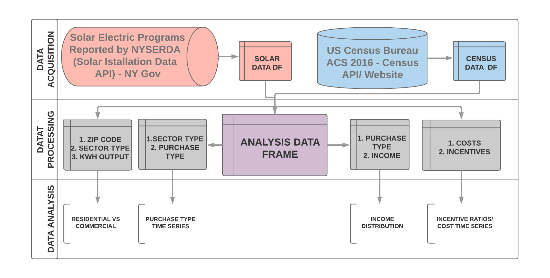
DATA & METHODS
Notes:
Vish (methods) – (120 seconds)
Alright, so in order to answer our key research questions, we went through three main steps: data acquisition, data processing, and finally, data analysis.
The first API provided a very rich data set on all the solar installations between 2000 and the present for the state of new york. The second API provided demographic data at the zip code level by the US Census Bureau.
After successfully calling these APIs and preprocessing their data, we merged both datasets into a final analysis data frame.
At this point in the data processing stage, each team member created their own branch on github for their specific analyses.
The first analyses segmented the data by zipcode, sector type, and the total KWh/ hour in order to analyze residential vs. commercial solar installations.
The second analysis segmented the data by both sector and purchase types. This allowed us to better understand the trends in solar financial innovations.
The third analysis segmented the dataframe by purchase type and then grouped these by income bins. This allowed us to get an income distribution for the solar installations.
And the last analysis looked at project costs. vs. project incentives to determine overall incentive ratios and a project cost time series.

Slide 4
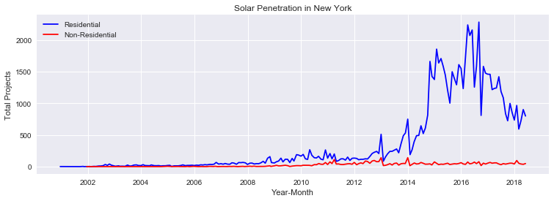
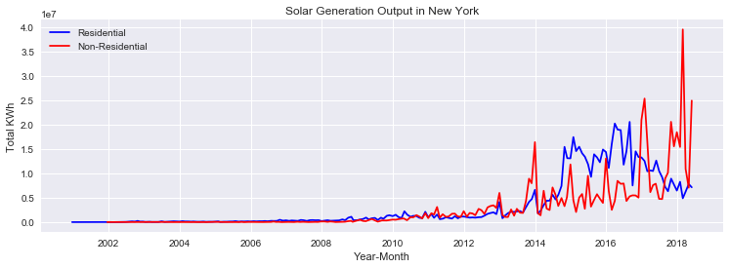
DISPARITY IN INSTALLATION AND ENERGY PRODUCTION BETWEEN SECTORS
The number of installations were several folds larger in residential sector than commercial
The energy output from fewer commercial sites were equal or larger than all residential installations together.
Notes:
The chart show solar installation over time for residential and commercial facilities.
New York wanted to follow other parts of the country who had solar programs. So between 2004 and 2008, two programs related to funding renewable energy, Renewable Portfolio Standard (RPS) and Energy Efficiency Portfolio Standards (EEPS) were formed. That is where the flurry of installations start to happen.
The residential adoption increased very quickly but has slowed down.
The number of residential installations dwarfs commercial installations.
The amount of solar output from commercial installations generated is much larger than residential installations even though the number of residential installation far outnumber commercial ones.

Slide 5
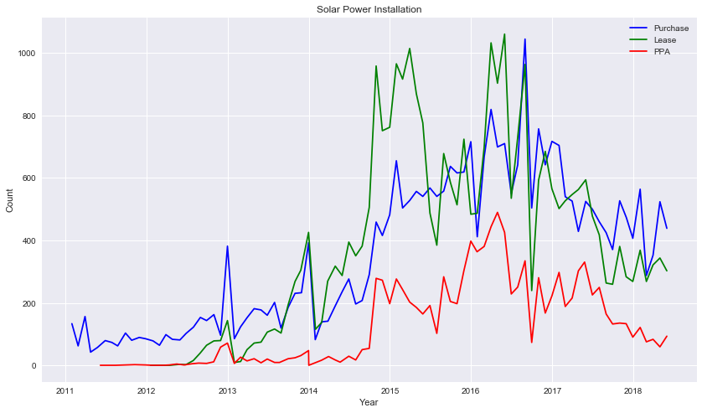
MOST PEOPLE PREFER TO LEASE EQUIPMENT OR BUY THE SOLAR POWER RATHER THAN PURCHASE
Financing programs for solar installations make up a larger proportion compared to purchasing solar panels.
Notes:
Three types of financial plans. Purchase, Lease, and Power Purchase Agreement
Lease and Power Purchase Agreement combined show that those are favored more than outright purchase.
The uptick in installations are noticeable around late 2012 because that’s when the leasing program and the power purchase programs were initially offered.

Slide 6
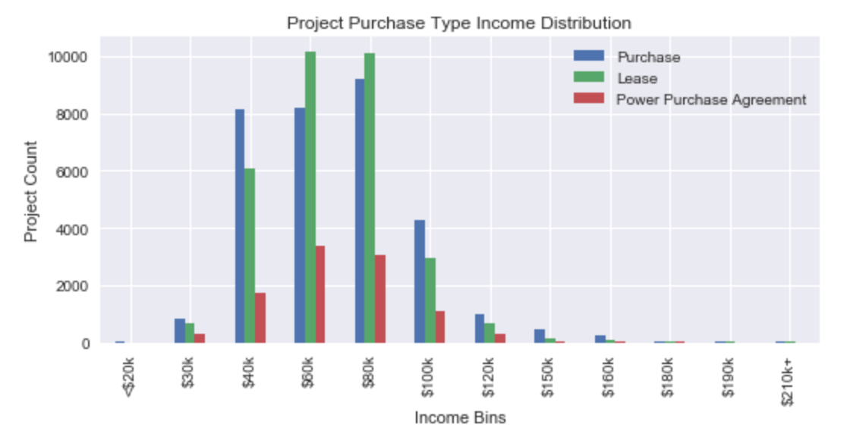
INCOME BIN VS PROJECT COUNT HAS A POISSON DISTRIBUTION
Majority of installations are within the $40,000 to $80,000 income bin
Effect of Gov. Subsidies?
additional time series analysis necessary
Notes:
for this analysis, we were interested in seeing how different financial innovations in solar related to different income bins
As expected, the income bin vs. project count had a poisson distribution - which intuitively makes sense because the wealthier zipcodes in NY are generally either in metropolitan areas, where residential rooftop solar is not possible.
The major point of this analysis was to uncover how gov. subsidies affected who decided to purchase solar and how they decided to purchase it. In order to unpack this further, we would want to complete additional time series analyses segmented by income bin to see if any upticks in project count could relate to a policy change.

Slide 7
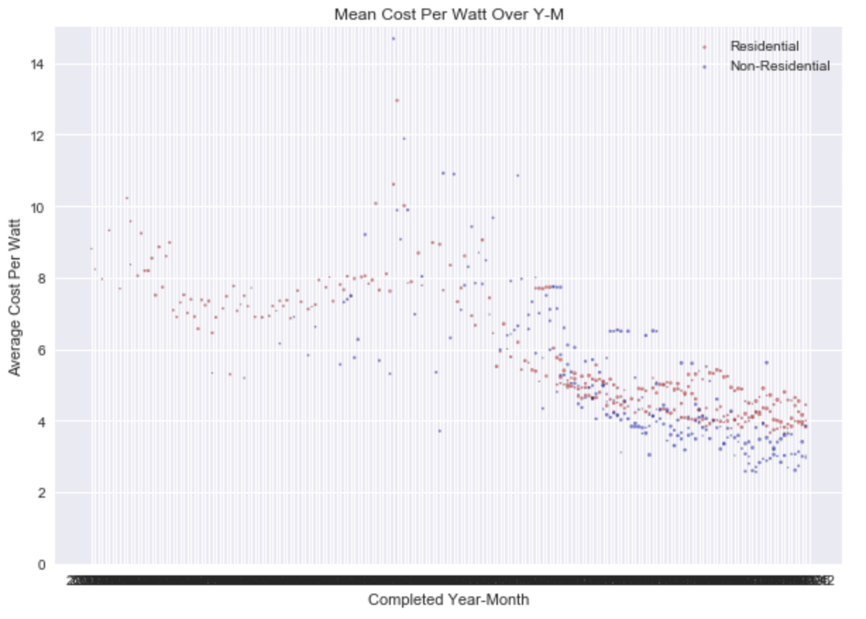
COSTS OF SOLAR ($/WATT) HAVE DECREASED OVER TIME
Though incentives have dropped off dramatically, the price per watt of solar has been even more dramatic

Slide 8
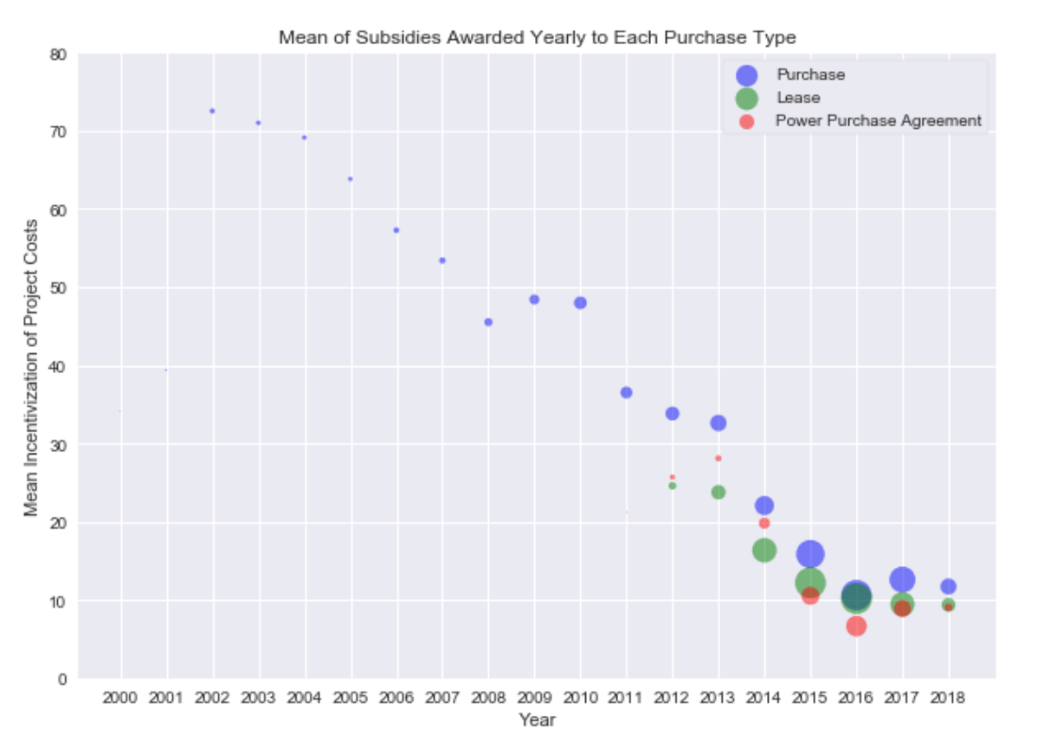
MEAN INCENTIVE RATIO PER PURCHASE TYPE OVER TIME
Purchased systems receive the highest rate of incentives proportional to cost
Purchasing and Leasing saw nearly matched incentive ratios in 2016.
Leasing’s highest project count year: 2016
Bubble Size =
# of projects per year / 25
Notes:
Aubrey 60 sec

Slide 9
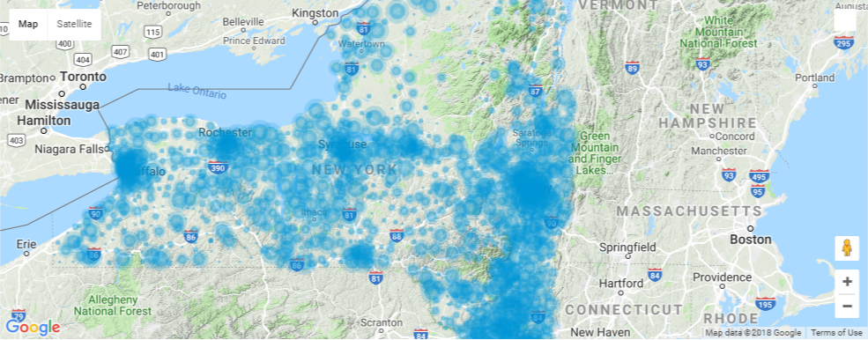
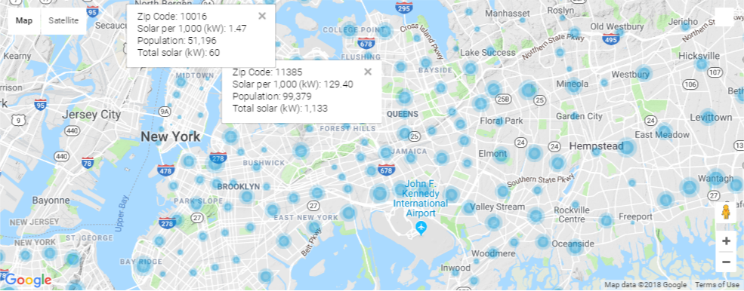
SOLAR PENETRATION IS NOT EVEN, IT’S CONCENTRATED IN SPECIFIC LOCATIONS
NYC Area
Notes:
Josh
One of the challenges with heatmaps that it only shows were the population is concentrated

Slide 10
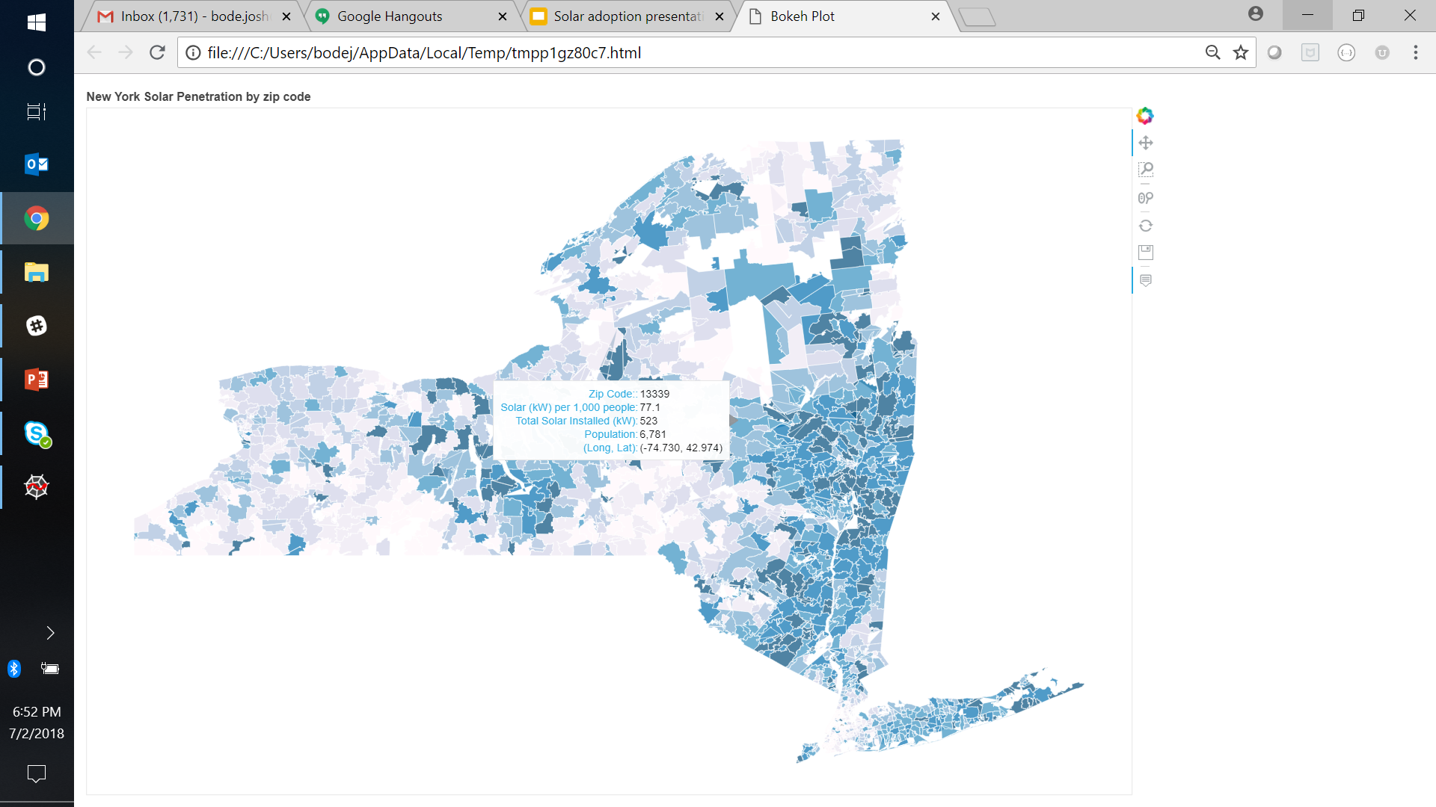
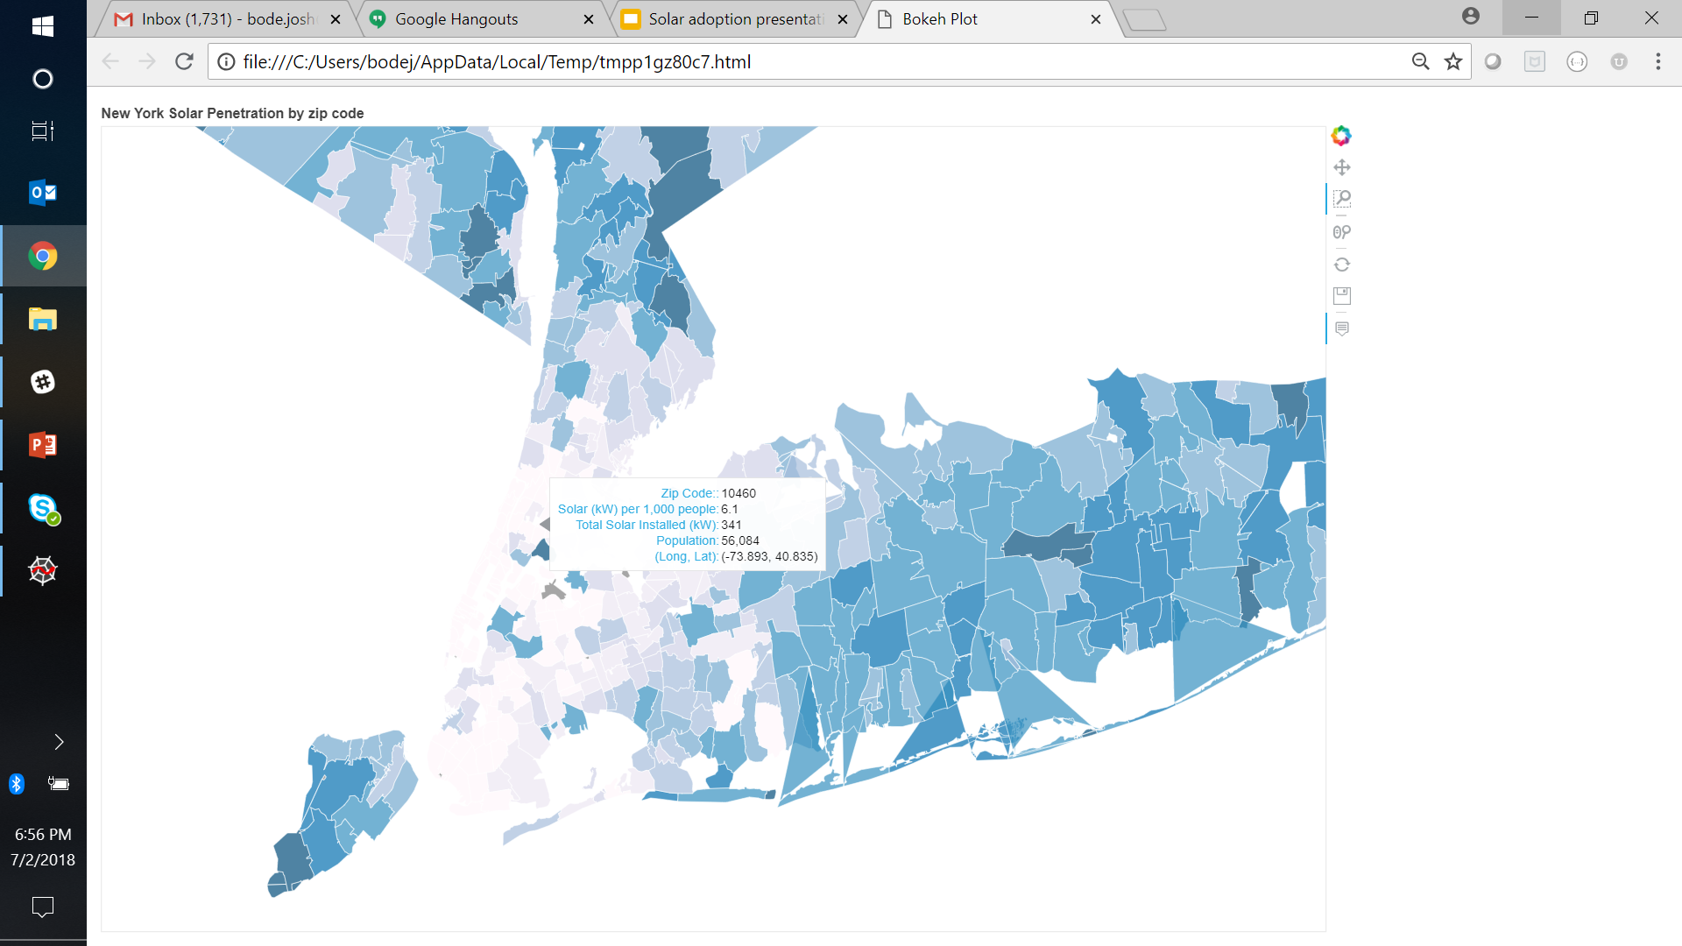
WE TRIED SEVERAL WAYS TO VISUALIZE THE DATA ON MAPS
NYC Area
Heat maps just showed were the general population was concentrated
Symbol layers (prior slide) were an improvement
Choropleth maps best identified locations with high/low per capita adoption
Notes:
Josh
We plotted the per capita amount of solar installation
Bigger bubbles mean you have higher installation rates
Not surprisingly, places like Manhattan have lower installation rates – less roof space

Slide 11
Key Findings and Lessons
Additional Research Questions
Adoption can be highly concentrated - project counts didn’t tell the full story
The cost of solar has decreased substantially but so have incentives and discounts
Not everyone who has solar owns it - it’s important to understand how buyers finance their rooftop solar
Double-check your work
Mapping can provide unexpected insights - e.g., high income areas like Manhattan have low solar adoption per capita
How does the cost of electricity affect solar purchasing decisions?
Which had a more important role in solar adoption - cost of solar, incentives, or new finance models?
Can the data be used to profile who is likely to adopt solar and to produced adoption forecasts?

Slide 12

QUESTIONS?
Team Green Tech
Vish
Dipesh
Aubrey
Josh B.

